Slide 1



Capstone Project Phase 2 Shelter Construction Information System
Project Supervisor:
Assoc. Prof. Zeev Barzily.
Presented by:
Almog Khaikin
Nir Betesh

Slide 2
Introduction
Project Purpose: To digitize and streamline the operations of a shelter construction company, transitioning from manual, paper-based processes to an efficient, automated system.
The Problem: Managing shelter construction through manual processes is time-consuming, error-prone, and inefficient. The need for a digital solution is crucial to improve project management, inventory control, and scheduling.

Slide 3
System Requirements
Contract Management: Create and manage contracts, with detailed tracking for each apartment.
Inventory Tracking: Real-time material tracking with alerts for low inventory to prevent shortages and theft.
Installer Scheduling: Schedule and track installer tasks efficiently.
User Role Management: Implement role-based access for different user roles.
Goal: To develop a user-friendly system that automates and streamlines the company's key operations.

Slide 4
Solution Overview
System Architecture
Frontend: Built with Svelte and SvelteKit for a responsive, user-friendly interface.
Backend: Powered by SvelteKit, handling data requests and business logic.
Database: Drizzle database for secure and efficient data storage.
TypeScript: Ensures strong typing and reduces errors in the codebase.
Functionality
Seamless User Experience: Intuitive interface tailored to non-technical users.
Robust Data Management: Secure handling of contracts, inventory, and scheduling data.

Slide 5
Key Features
Contract Management: Create and manage contracts with detailed tracking for each apartment shelter building within multi-unit buildings.
Inventory Tracking: Monitor inventory levels in real-time, with automated alerts for low stocks to prevent shortages and thefts.
Installer Scheduling: Schedule tasks for installers, with real-time tracking of progress to ensure timely completion of projects.
User Role Management: Role-based access control to ensure that users only interact with the system features relevant to their roles.
Impact: These features ensure the company operates efficiently, reduces errors, and maintains accountability across all projects.

Slide 6
Project Metrics
Usability
User Feedback: Easy to use the system.
Training Time: Short training time due to the intuitive interface.
Performance
Response Time: Fast and reliable system performance under typical usage scenarios.
Data Handling: Efficient management of contracts, inventory, and scheduling.
Efficiency
Error Reduction: Significant reduction in manual errors compared to previous paper-based processes.
Resource Management: Good tracking and utilization of inventory.
Overall Success: The system has successfully met the project's goals.

Slide 7
Challenges and solutions
Learning New Technologies
Challenge: Adapting to Svelte, SvelteKit, and TypeScript was initially challenging.
Solution: Dedicated time for learning led to understanding the new technonogies.
College Restrictions
Challenge: Restrictions on accessing on Drizzle, hindered development.
Solution: Alternative development environments.
Continuous Refactoring
Challenge: As familiarity with the technologies grew, the need for refactoring became evident.
Solution: Regular refactoring sessions were held to optimize code.
Outcome:Overcoming these challenges has resulted in a robust and efficient system, with the team gaining valuable experience in problem-solving and adapting to new technologies

Slide 8
Testing
Development is divided into iterations (sprints).
After each sprint, unit and integration tests are run using Vitest.
Regression testing ensures that new changes do not break existing functionality.
New features are validated for proper behavior.
Continuous feedback helps refine the backlog and improve the product.

Slide 9
System View
Premissions:
CEO – ALL
Secretary
Team lead
Inventory manager
Login
View and edit employees
View daily scheduel
Update daily schedule
Create new contract
View and update items
View teams
Update contract status
View contracts
View and handle shortages

Slide 10
Project Conclusions
Agile development methodology with sprints allowed for flexibility and iterative improvements.
Svelte, SvelteKit, TypeScript, and Drizzle enabled efficient, type-safe, and scalable application development.
Continuous testing using Jest ensured the system's stability, catching regressions and maintaining code quality.
Role-based access control enhanced security by restricting critical operations to authorized users only.
Clear team roles and management features streamlined communication and increased project efficiency.
The system's design ensures scalability, with flexibility for managing detailed contract and inventory data.

Slide 11
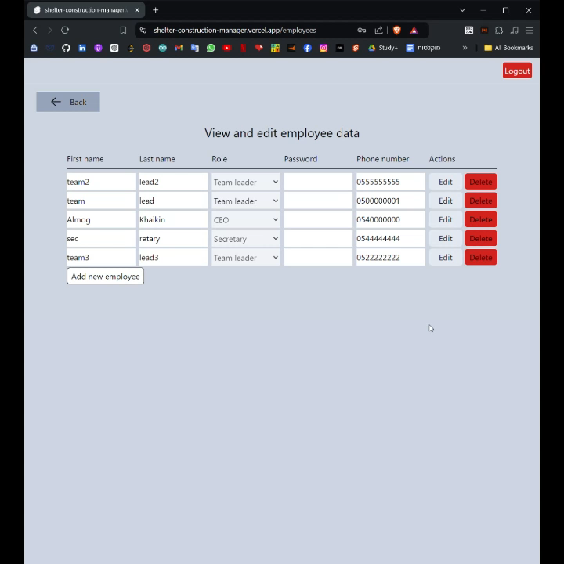
Demonstration

Slide 12
Thank you! Any questions?

